Slide 1
Hash Tables
An Introduction

Slide 2





























Searching Time in Primary Data Structures

Slide 3














































Can We Make Searching Faster? Hashing

Slide 4
































Slide 5



















Hash Tables in Dictionaries

Slide 6

































Hash function

Slide 7










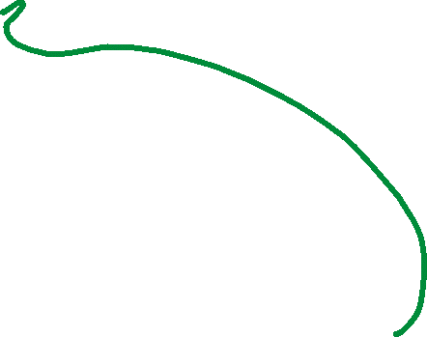



























Collision and Handling

Slide 8



















Chaining

Slide 9


























Slide 10
class Node:
def __init__ (self,key,val):
self.key = key
self.val = val
self.next = None
def insert(keys,values,hash):
i = 0
while (i<len(keys)): # for every key generate an index using the hashF ( )
index = hashF(keys[i])
# check for collision
if (hash[index]==None):
# 0 means no element is occupying the space
# as we are using chaining, the best idea is to treat every element as a node
# hence we create a node with both the key and the value
# store in the hash array at index i
# note that this is the first node inside the index hence it will
# work as the head of the linked list starting from that particular index
n = Node(keys[i],values[i])
hash[index] = n
else: # is there is a collision, reach to the last node and link
h = hash[index]
while(h.next!=None):
h = h.next
h.next = Node(keys[i],values[i])
i = i+1

Slide 11



















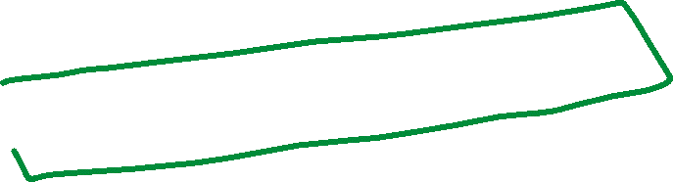






Slide 12



















Slide 13



































Slide 14















